Slide 1
Algorithm for Treatment of T2DM to Initiate or Intensify Injectable Therapy in Iraq
Initiate or intensify injectable therapy
HbA1c < 2% from target
HbA1c ≥ 2% from target
BMI ≤ 30
BMI > 30
BMI ≤ 30
BMI > 30
Basal insulin ⃰⃰⃰
& titration
GLP-RA ⃰⃰ ⃰⃰
or BI + GLP-1 RA ⃰ ⃰
(FRC or separately)
BI + GLP-1 RA ⃰ ⃰
(FRC or separately)
Or Premix agents♯
BI + GLP-1 RA ⃰ ⃰
(FRC or separately)
If HbA1c above Target
BI + GLP-1 RA ⃰ ⃰
(FRC preferably or separately)
If HbA1c above Target
BI + GLP-1 RA ⃰ ⃰ (BI max dose) + Rapid Acting Insulin
If HbA1c above Target
Basal +/ Bolus Insulin
OR
Premix insulin
Intensify insulin
⃰⃰ 2nd generation Basal Insulins are preferred over older generations
⃰ ⃰The choice of GLP-1 RA is based on patient-specific considerations, including established CVD, CKD, desired weight benefit, access and cost
♯ Complex insulin regimens (such as premix insulins) may be used as alternatives if other options are not accessible locally
HbA1c: Glycated Hemoglobin
BI: Basal Insulin
GLP-1 RA; Glucagon-like peptide-1 receptor agonists
BMI: Body Mass Index
FRC: Fixed Ratio Combination
Notes:
Iraqi consensus: Saab et al., Diabetes Therapy 2026; Iraqi Injectable Therapy Algorithm
Experts’ recommendations on injectable therapy use for T2D management
The expert EACG has developed practical recommendations on insulin initiation and titration for patients with T2DM in the Gulf region.
The expert’s recommendations and reflections include the real-world approach to PCPs, supported by ADA/EASD/IDF/NICE guidelines for insulin initiation, optimization, and maintenance in T2DM.
Second-generation insulin analogs (IGlar 300/ Degludec) offer significant clinical benefits compared to first-generation analogs in randomized clinical trials, meta-analyses, and real-world studies. Studies have demonstrated less hypoglycemia with second-generation BI analogs compared to first-generation BI analogs in older adults and those with renal impairment, obesity, and CV disease.

Slide 2
One-Glance Decision Flow for Initiating and Intensifying Injectables
Clinical Situation | Recommended Strategy | Iraqi Practice Emphasis
HbA1c < 2% above target, BMI ≤30 | Basal insulin (2nd generation) + titration | Advance to BI + GLP-1 RA or FRC if not at target
HbA1c < 2% above target, BMI >30 | Basal insulin + GLP-1 RA | FRC preferred due to access and simplicity
HbA1c ≥ 2% above target (all BMI) | Initiate BI + GLP-1 RA | FRC positioned as default option
Persistent uncontrolled HbA1c | Further intensification | Add rapid-acting insulin; premix only if others unavailable
Notes:
This executive slide presents a concise, decision-driven visual algorithm for initiating or intensifying injectable therapy in adults with type 2 diabetes mellitus (T2DM) in Iraq. The flowchart is intentionally structured for rapid clinical use, starting with the core trigger—insufficient glycemic control on oral antidiabetic drugs—and immediately stratifying patients by HbA1c deviation from target. When HbA1c is less than 2% above target, the algorithm emphasizes a fasting-first strategy. For patients with BMI ≤30, second-generation basal insulin with structured titration is recommended as the standard first injectable, reflecting both international evidence and Iraqi expert consensus. Importantly, if targets are not achieved, the pathway clearly advances to basal insulin plus GLP-1 receptor agonist delivered as a fixed-ratio combination (FRC), which is highlighted as the preferred option in Iraq due to limited access to standalone GLP-1 RAs. For patients with BMI >30 in the same HbA1c category, the algorithm moves directly to BI + GLP-1 RA, again prioritizing FRC to achieve combined fasting and postprandial control while maintaining weight neutrality and regimen simplicity. When HbA1c is ≥2% above target, signaling a higher glycemic burden, the flowchart removes BMI as a barrier and recommends early combination therapy for all patients. Initiation with BI + GLP-1 RA is advised upfront, with FRC visually positioned as the default choice, reinforcing its role as a pragmatic, evidence-based solution in the Iraqi healthcare setting. The final segment of the slide addresses reassessment and intensification. If glycemic targets remain unmet despite optimized basal dosing (approximately 0.5 U/kg/day or signs of over-basalization), clinicians are guided to intensify while preserving simplicity—first by maximizing BI + GLP-1 RA, then, only if necessary, by adding rapid-acting insulin in a basal-plus or basal-bolus approach. Premixed insulin is deliberately placed as an alternative reserved for situations where other options are inaccessible. Overall, the slide communicates three key messages: prioritize simplicity, introduce combination therapy early when glycemic burden is high, and recognize FRC as the most practical way to deliver GLP-1 RA benefits in Iraq.

Slide 3
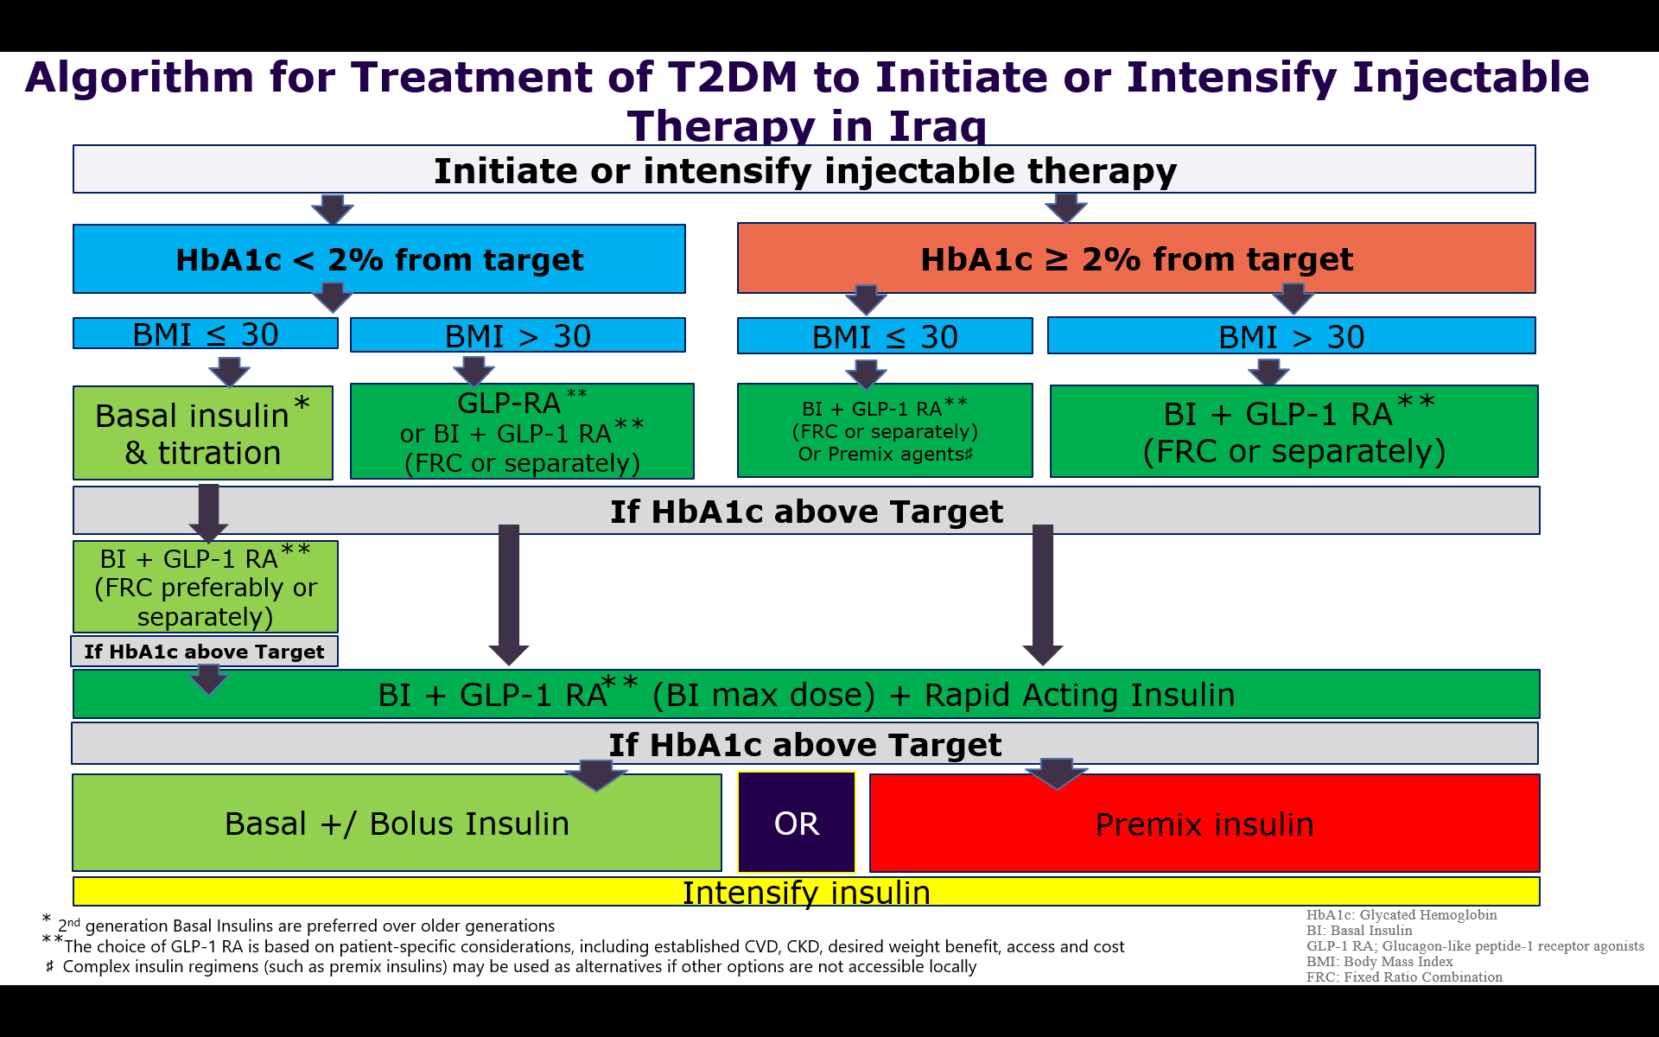
T2D Injectable Therapy CDS
1- None / first injectable selection
HbA1c < 2%
BMI ≤ 30
Iraqi consensus: Saab et al., Diabetes Therapy 2026; Iraqi Injectable Therapy Algorithm

Slide 4
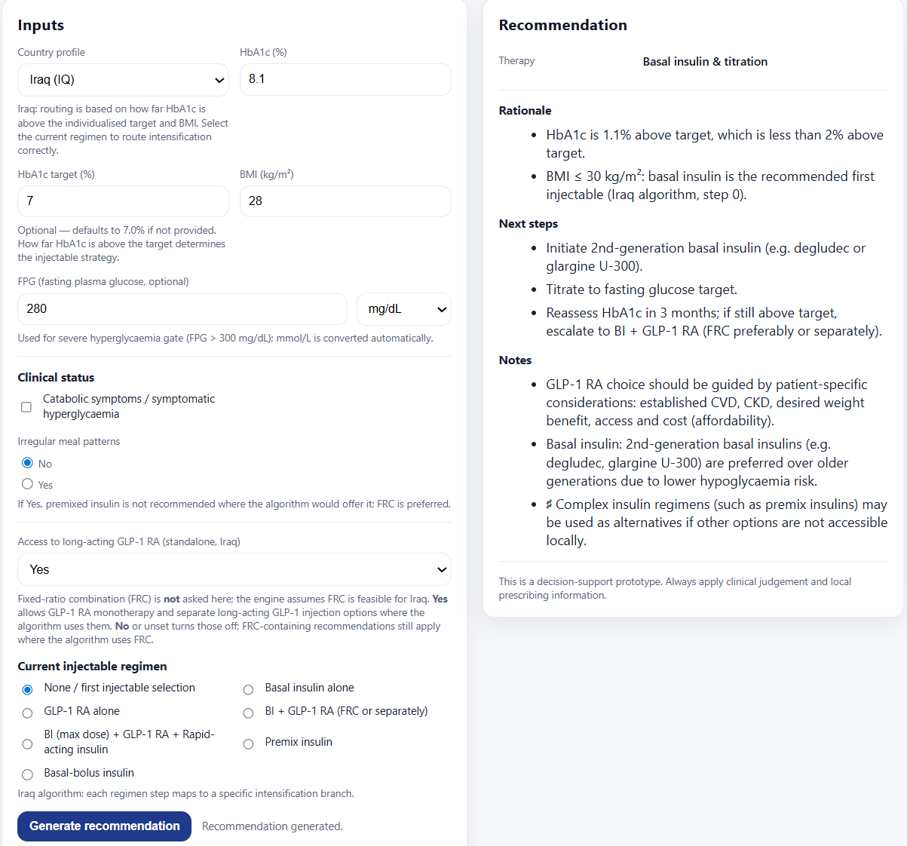
Start
up to 0.5 U/kg/day
None / first injectable selection
HbA1c < 2%
BMI ≤ 30
2nd gen especially in elderly and CKD patients
Simpler regimens prioritized before complex insulin strategies
Notes:
“insulin straight away” rule if any ONE of the following is present:
A1C ≥10% OR
Fasting/random glucose ≥300 mg/dL OR
catabolic symptoms (e.g., weight loss, polyuria, polydipsia)
In patients with HbA1c < 2% above target and BMI < 30, basal insulin remains the standard first injectable option.

Slide 5
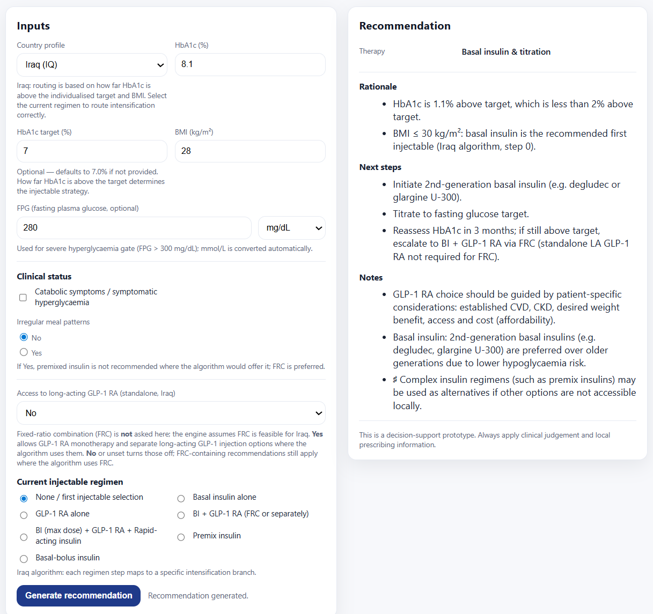
None / first injectable selection
HbA1c < 2%
BMI ≤ 30
No access to GLP1-RA

Slide 6

None / first injectable selection
HbA1c < 2%
BMI ≤ 30
Irregular meal pattern

Slide 7
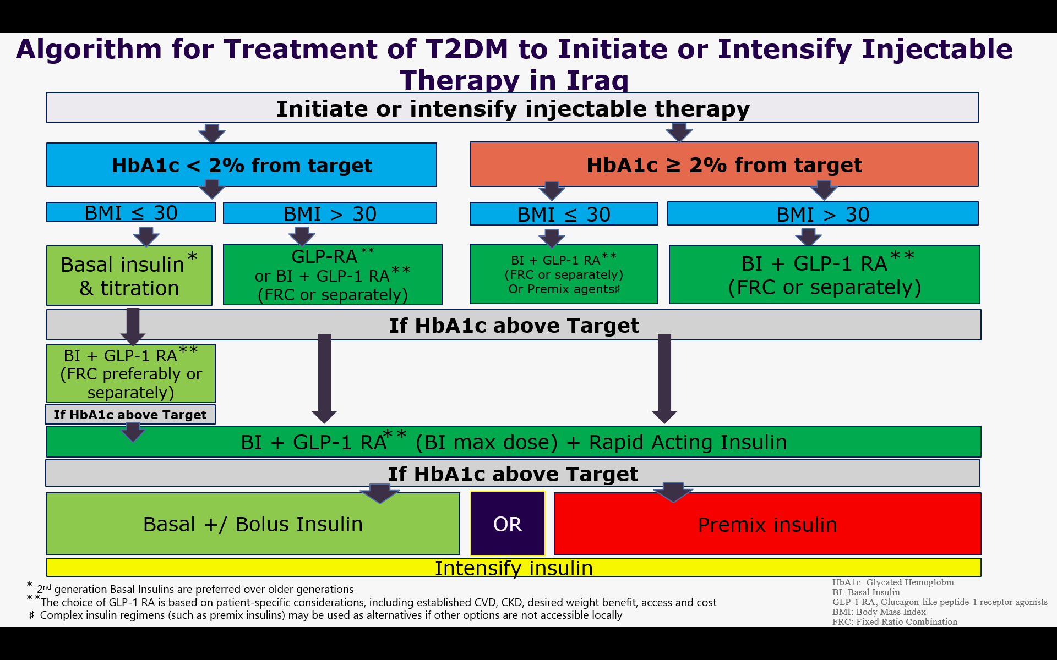
2- None / first injectable selection
HbA1c < 2%
BMI > 30

Slide 8
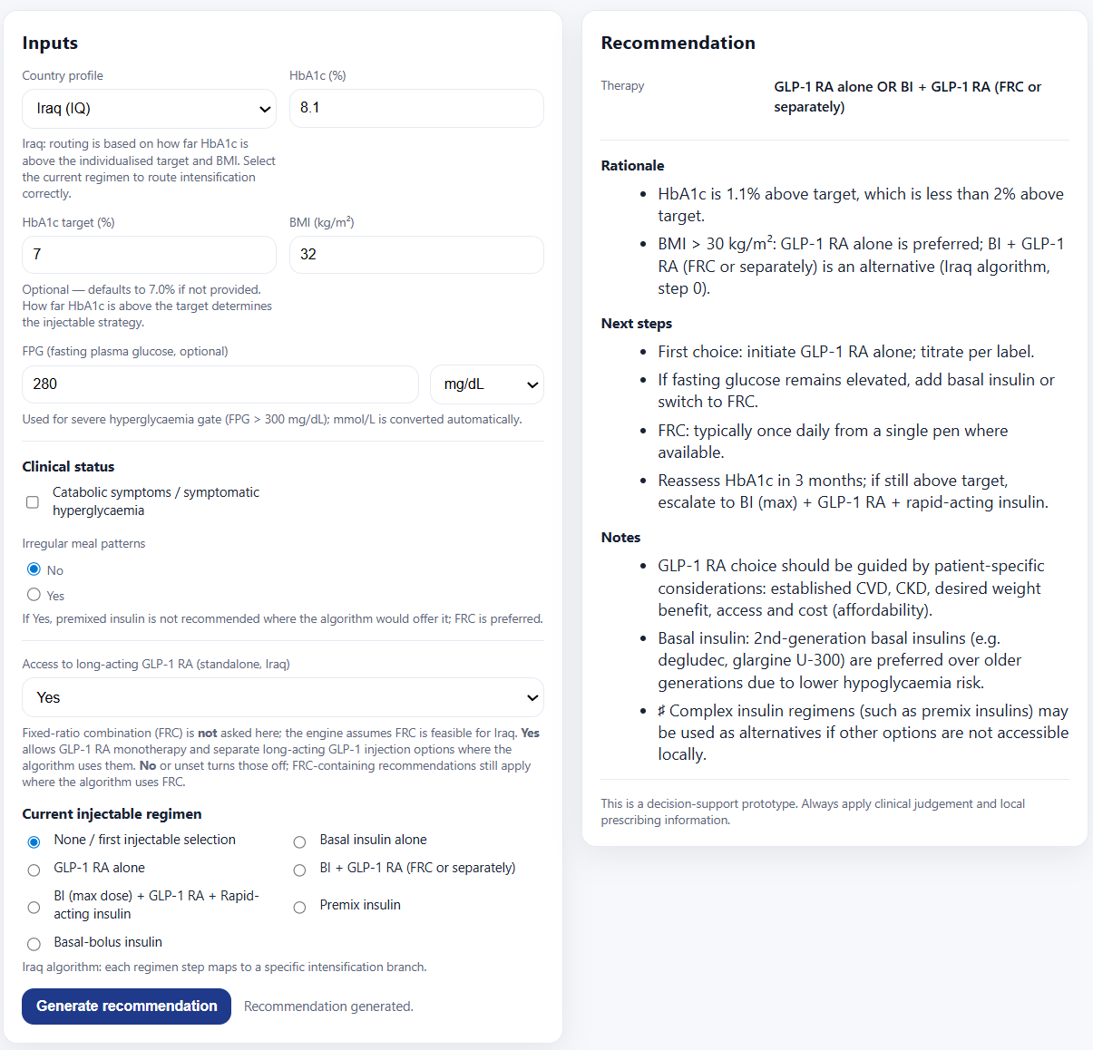
Start
None / first injectable selection
HbA1c < 2%
BMI > 30
⬆ If still uncontrolled, add Basal Insulin or start FRC
-2nd‑generation basal insulins are preferred due to lower hypoglycemia risk
-Choice of GLP‑1 RA is guided by patient profile (CVD, CKD, weight goals), access, and cost (affordability)
-In Iraq, fixed‑ratio combinations provide a pragmatic and simplified way to deliver GLP‑1 RA therapy
-Complex insulin regimens (premix or basal‑bolus) should be reserved for cases where simpler strategies fail or are unavailable

Slide 9
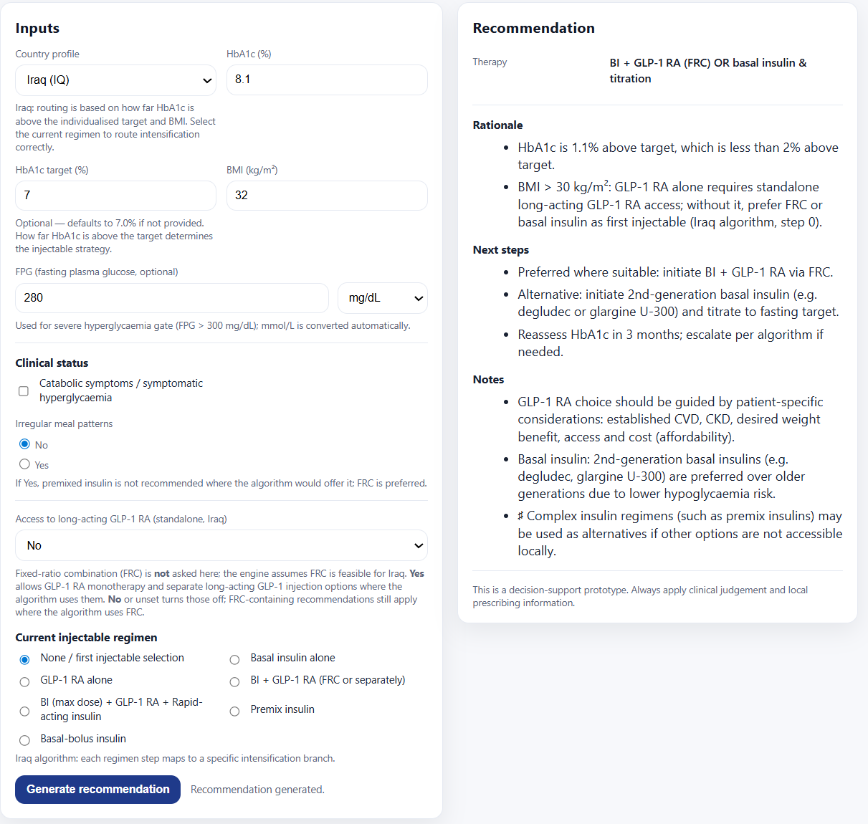
BI + GLP‑1 RA (FRC) (when standalone GLP‑1 RA is inaccessible, or not well tolerated)
No 2nd gen as alternative
None / first injectable selection
HbA1c < 2%
BMI > 30
No access to GLP1-RA
Notes:
FRC is a simplified, effective alternative when GLP‑1 RAs are unavailable or unaffordable
BI + GLP‑1 RA (FRC) (when standalone GLP‑1 RA access is limited)

Slide 10
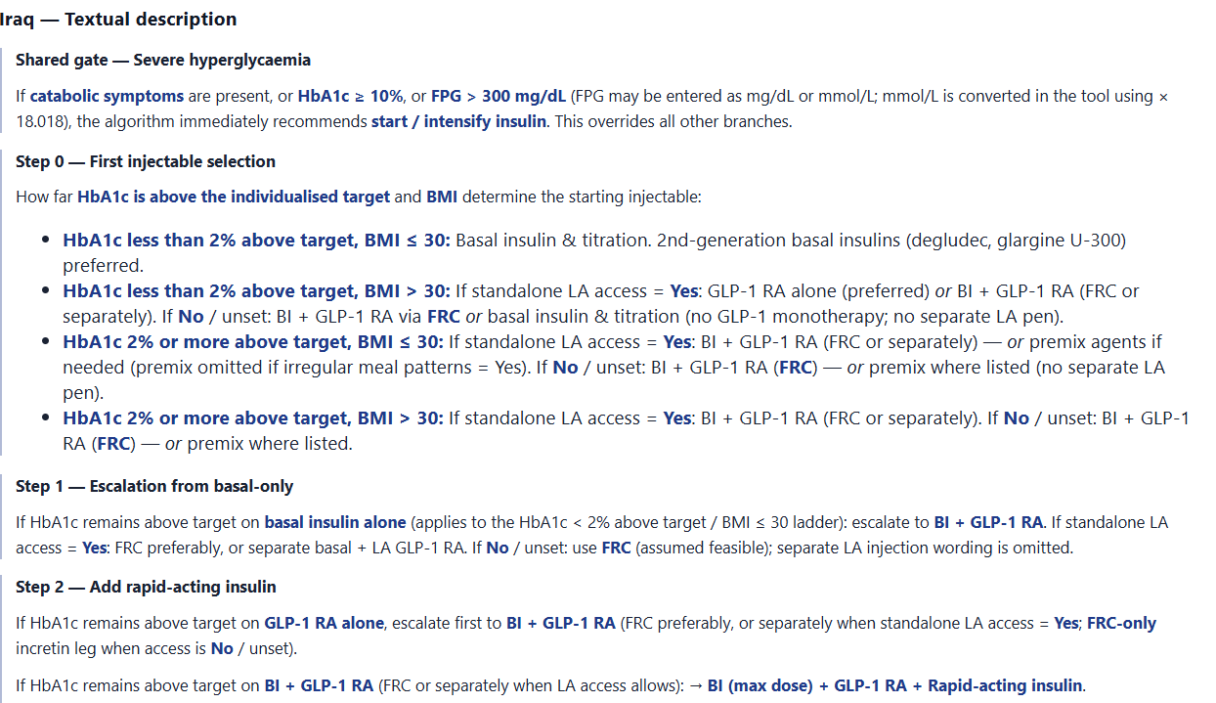
remove Premix. it is not given in obesity

Slide 11
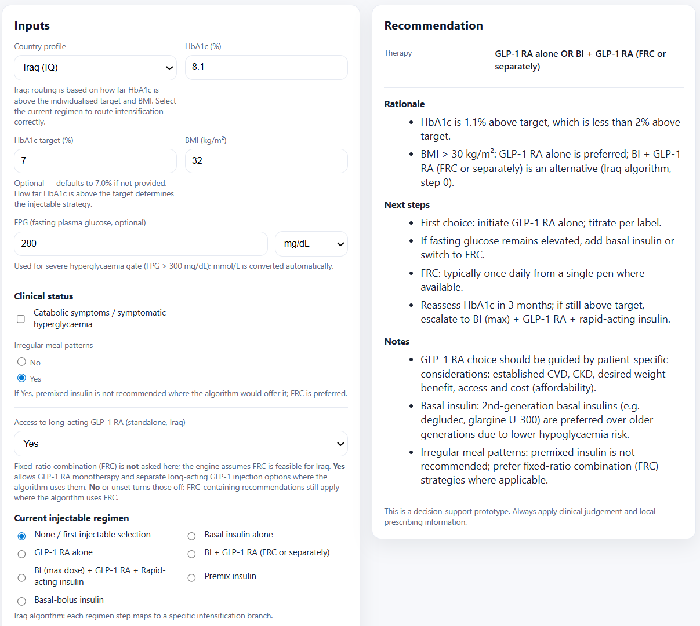
None / first injectable selection
HbA1c < 2%
BMI > 30
BMI and weight considerations favor GLP‑1 RA–based combinations
⬆ If still uncontrolled, add Basal Insulin or start FRC
Irregular meal pattern

Slide 12
3- None / first injectable selection
HbA1c ≥ 2%
BMI ≤ 30

Slide 13
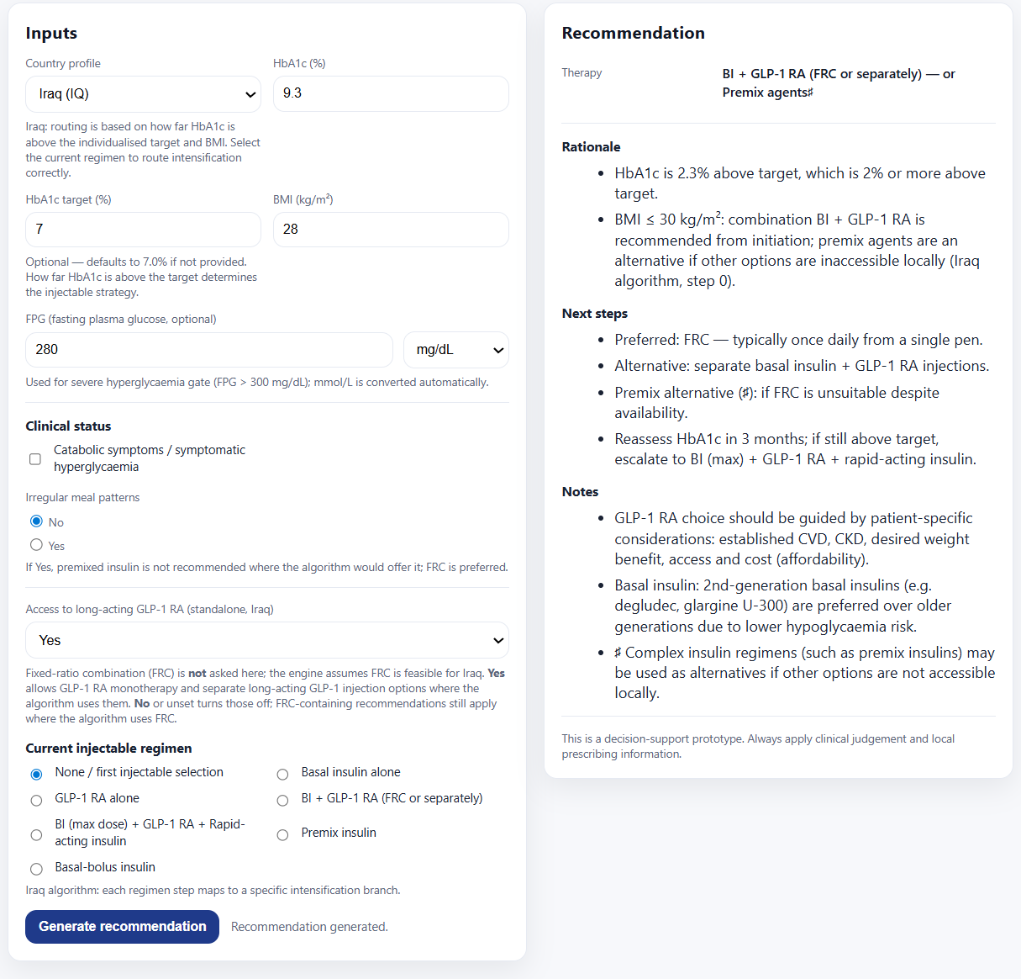
None / first injectable selection
HbA1c ≥ 2%
BMI ≤ 30
“Complex insulin regimens (such as premix) may be used as alternatives when other options are not accessible”
Premix agents cause higher hypoglycemia risk, require regular meals with greater rigidity → lower adherence in many patients
Notes:
Iraqi consensus prioritizes early combination injectable therapy when HbA1c ≥2%, regardless of BMI
“Complex insulin regimens (such as premix) may be used as alternatives if other options are not accessible locally”

Slide 14
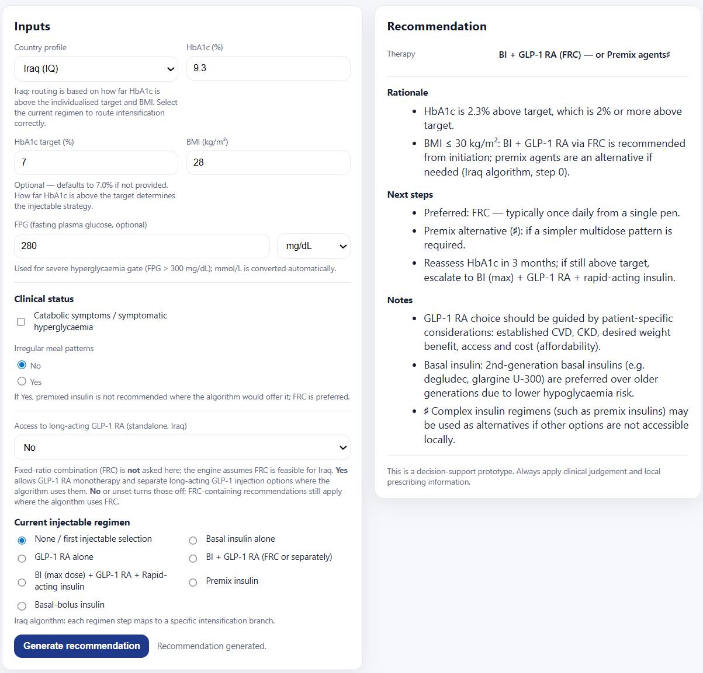
None / first injectable selection
HbA1c ≥ 2%
BMI ≤ 30
No access to GLP1-RA

Slide 15
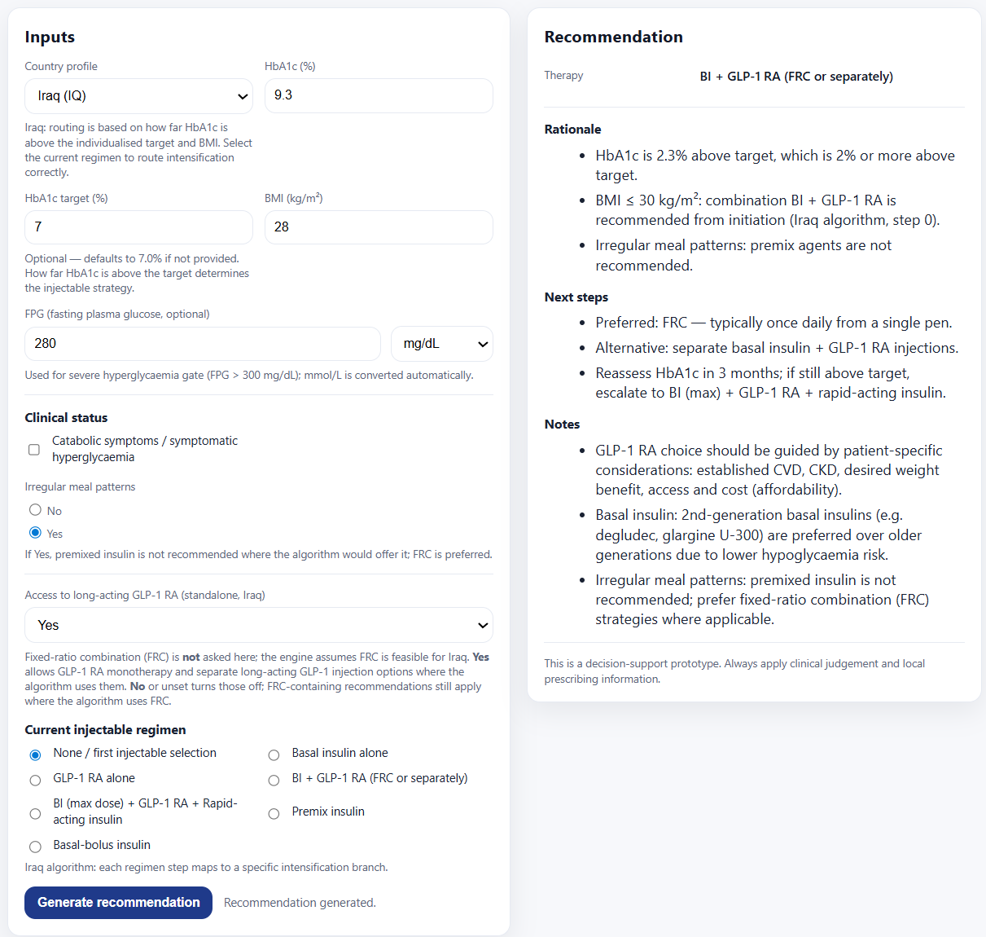
None / first injectable selection
HbA1c ≥ 2%
BMI ≤ 30
Irregular meal pattern

Slide 16
4- None / first injectable selection
HbA1c ≥ 2%
BMI > 30

Slide 17
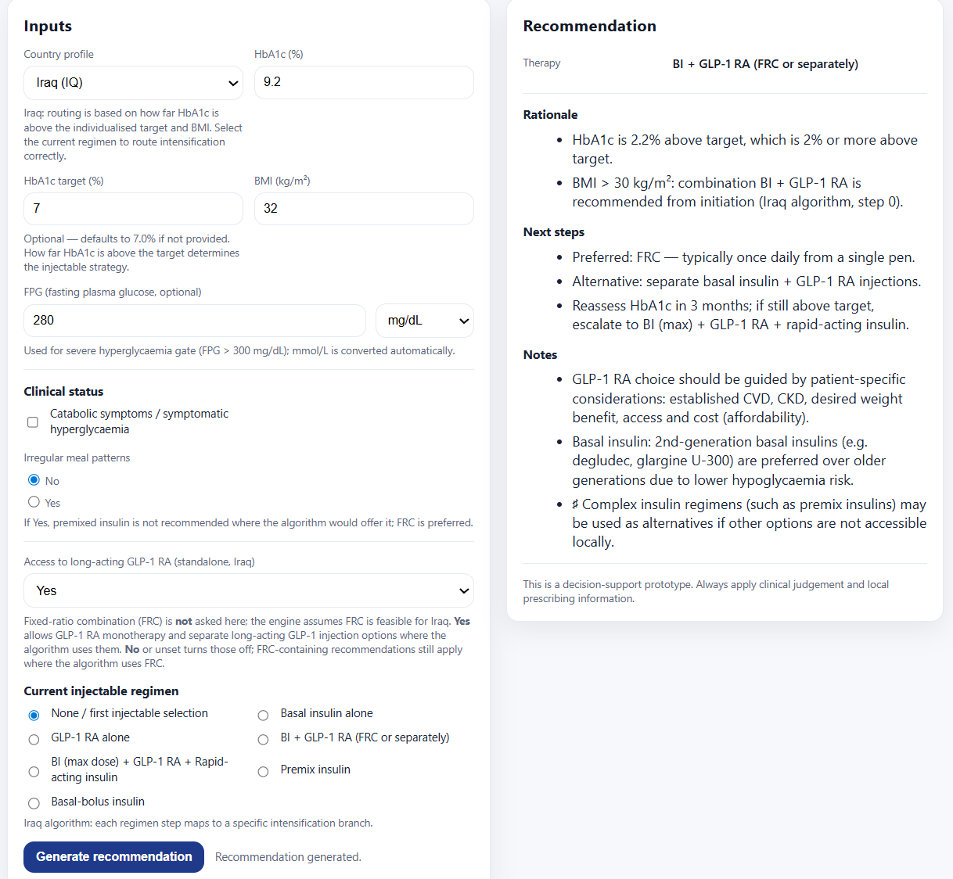
None / first injectable selection
HbA1c ≥ 2%
BMI > 30

Slide 18
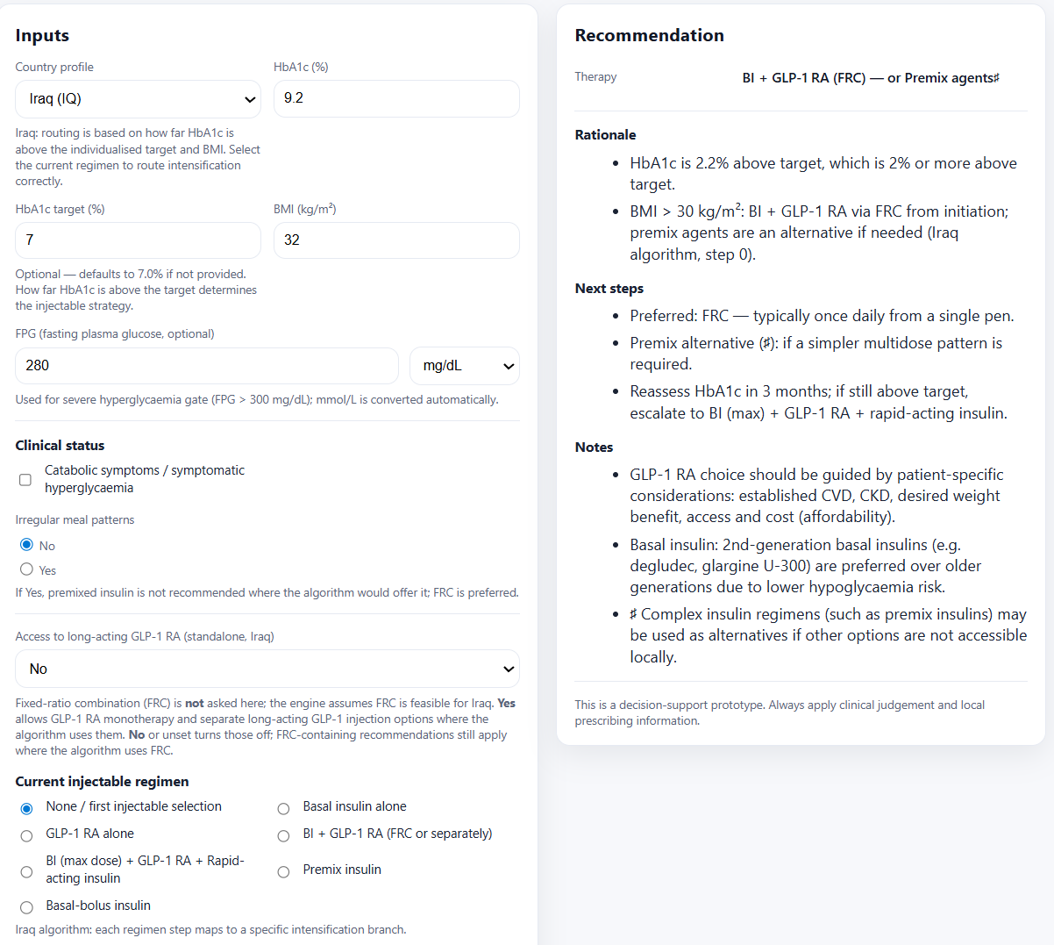
None / first injectable selection
HbA1c ≥ 2%
BMI > 30
In Iraq, FRC provides the most feasible access to GLP‑1 RA therapy.
No access to GLP1-RA

Slide 19

None / first injectable selection
HbA1c ≥ 2%
BMI > 30
Irregular meal pattern

Slide 20
T2D Injectable Therapy CDS
After BI Failure

Slide 21
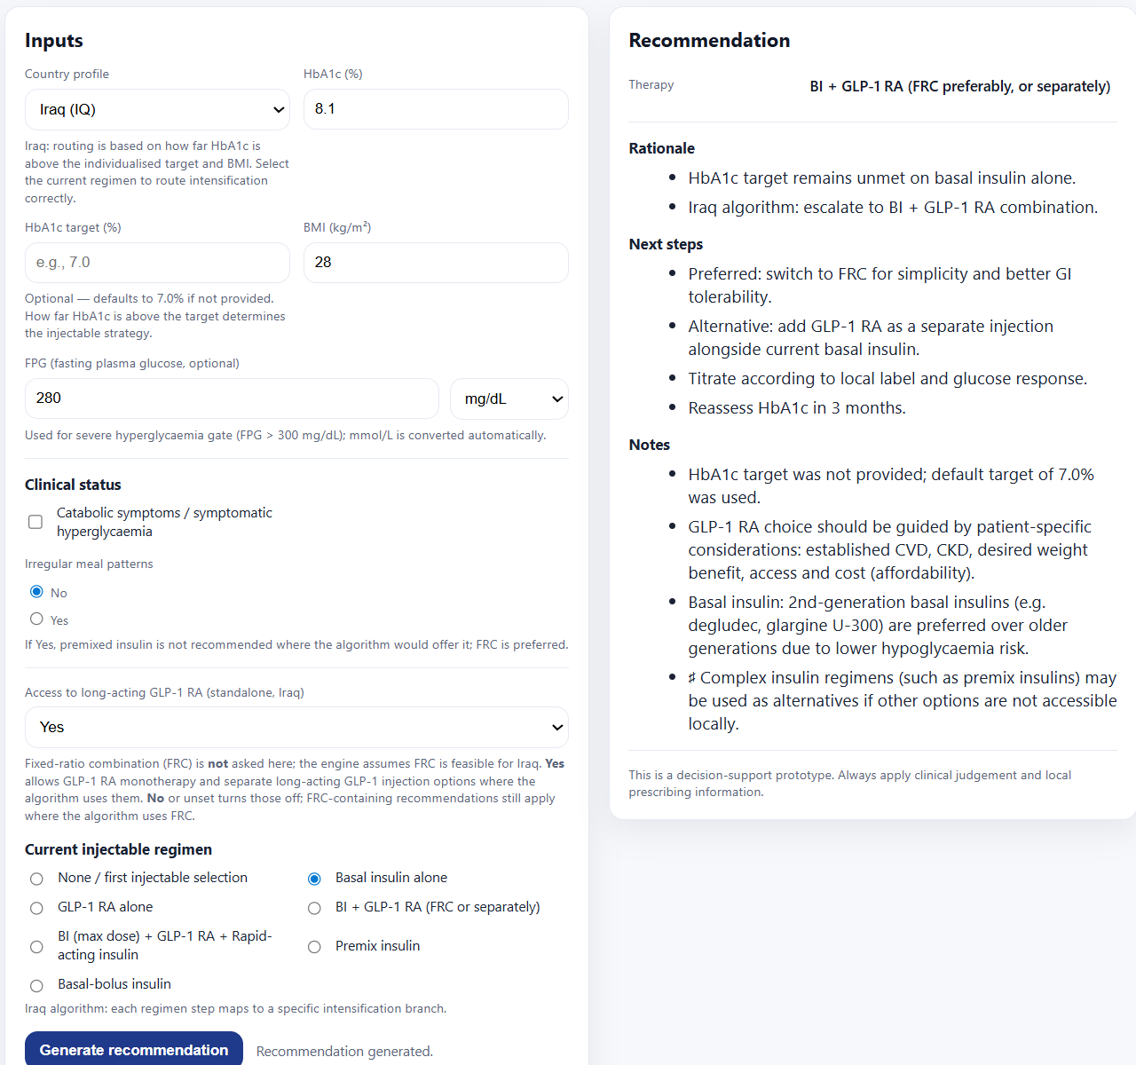
Despite maximum titration
After BI failure
HbA1c < 2%
BMI ≤ 30

Slide 22
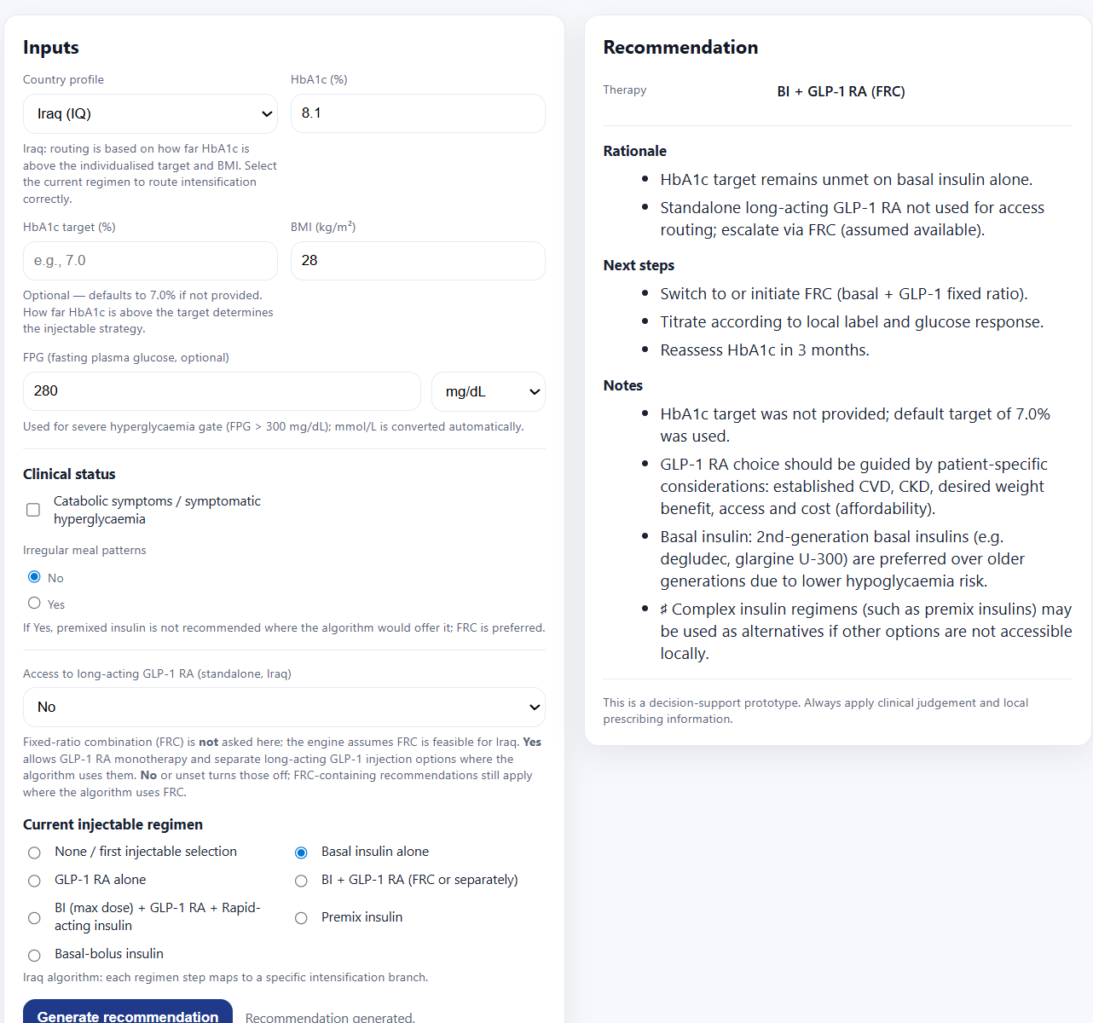
BI + GLP‑1 RA (FRC) (when standalone GLP‑1 RA is not accessible, or not tolerated)
After BI failure
HbA1c < 2%
BMI ≤ 30
No access to GLP1-RA

Slide 23
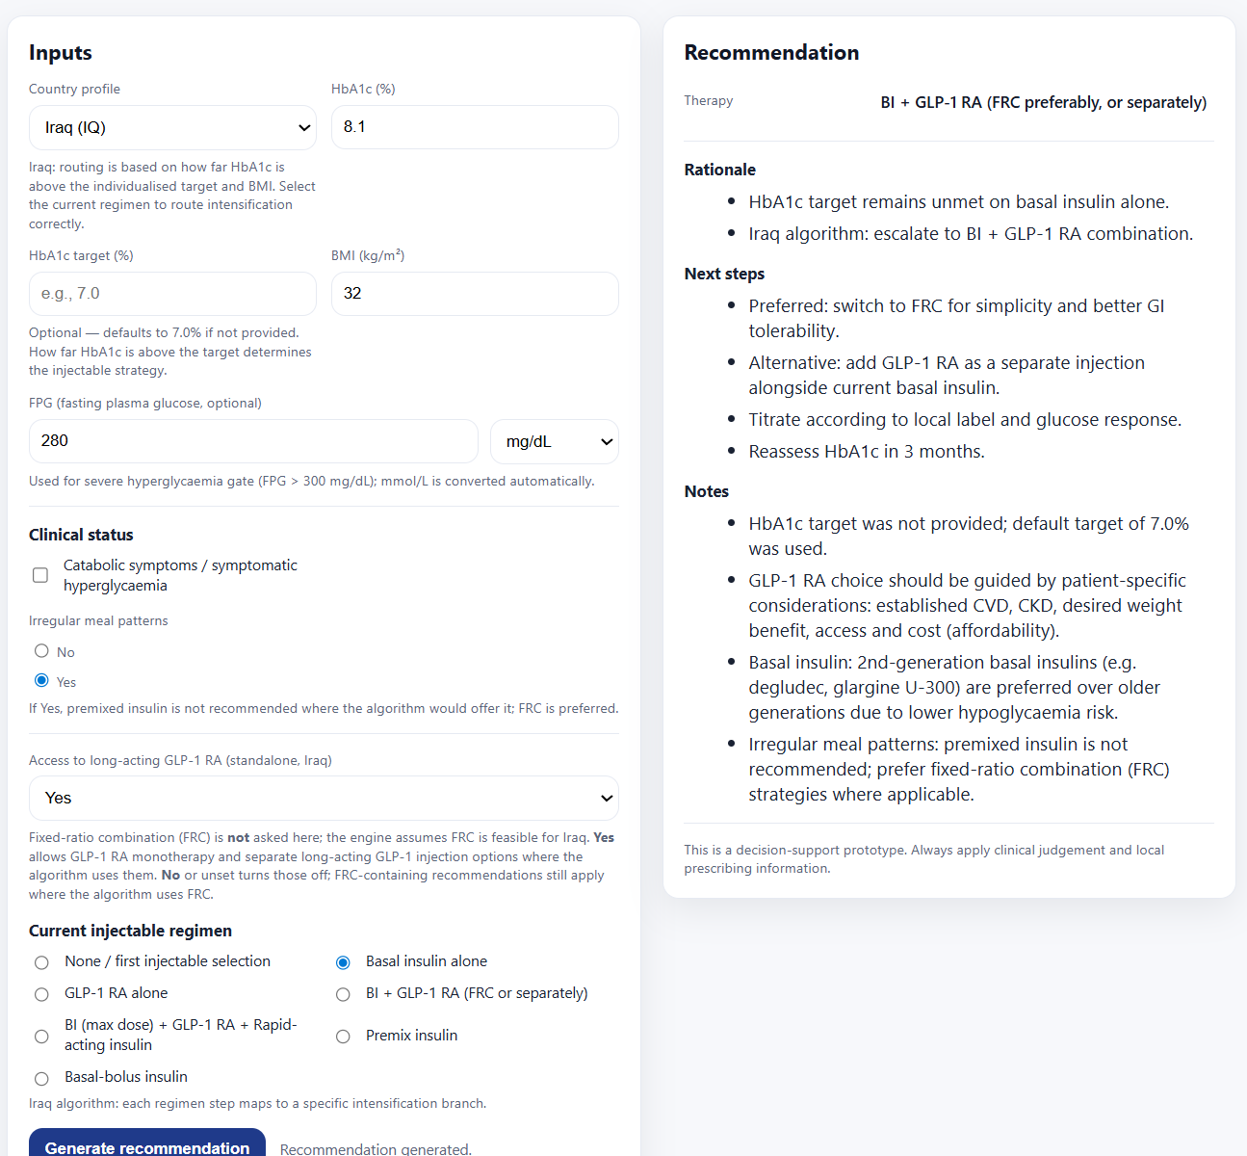
BMI and weight considerations favor GLP‑1 RA–based combinations
After BI failure
HbA1c < 2%
BMI > 30

Slide 24
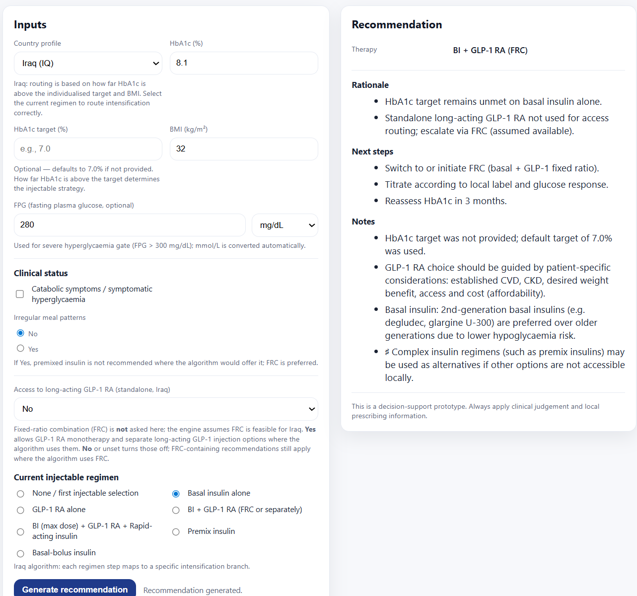
BI + GLP‑1 RA (FRC) (when standalone GLP‑1 RA is not accessible, or not tolerated)
After BI failure
HbA1c < 2%
BMI > 30
No access to GLP1-RA

Slide 25
T2D Injectable Therapy CDS
After GLP1-RA Failure

Slide 26
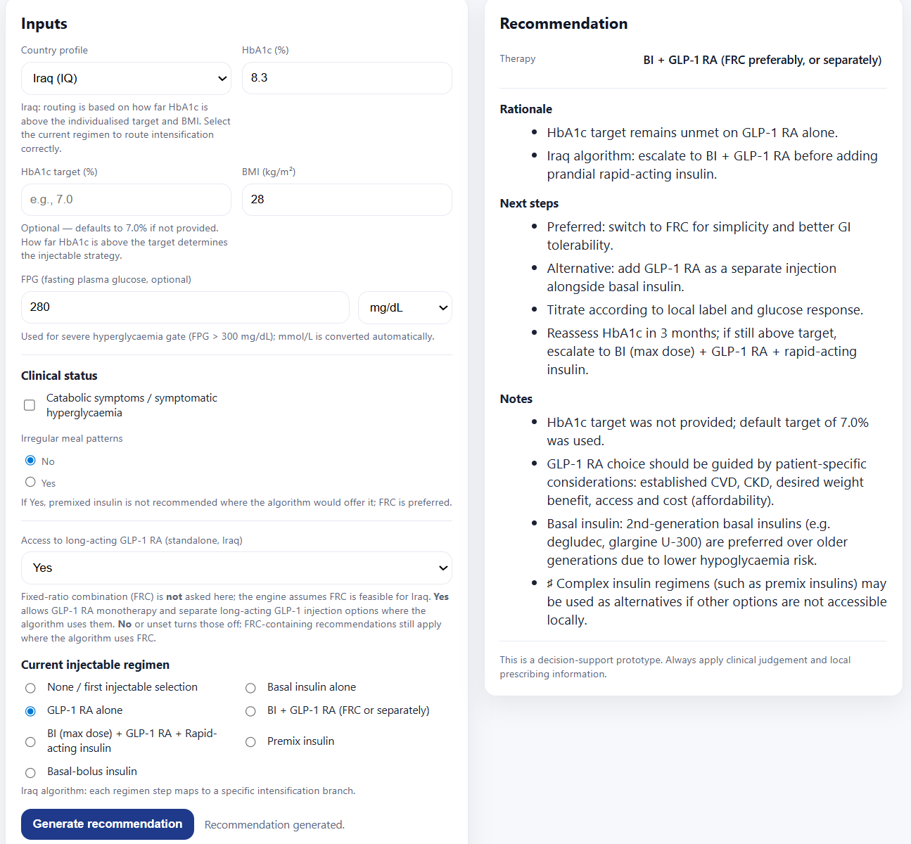
After GLP1-RA failure Regardless of HbA1c & BMI (depends on access to GLP1 RA)

Slide 27
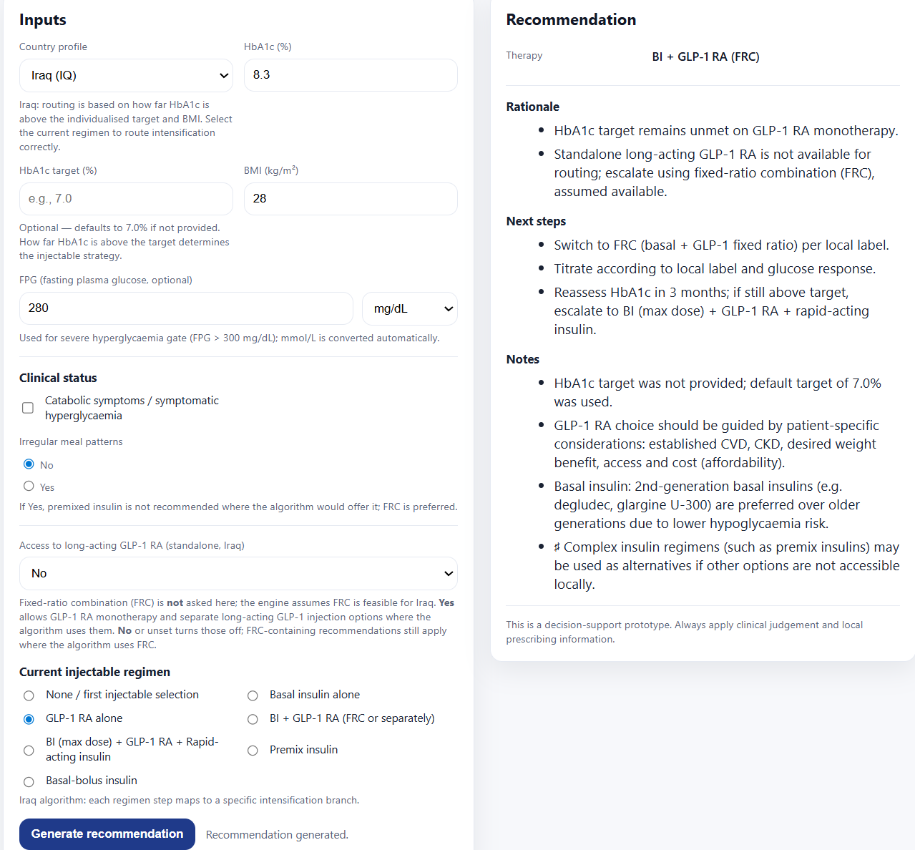
After GLP1-RA failure Regardless of HbA1c & BMI (depends on access to GLP1 RA)
No access to GLP1-RA

Slide 28
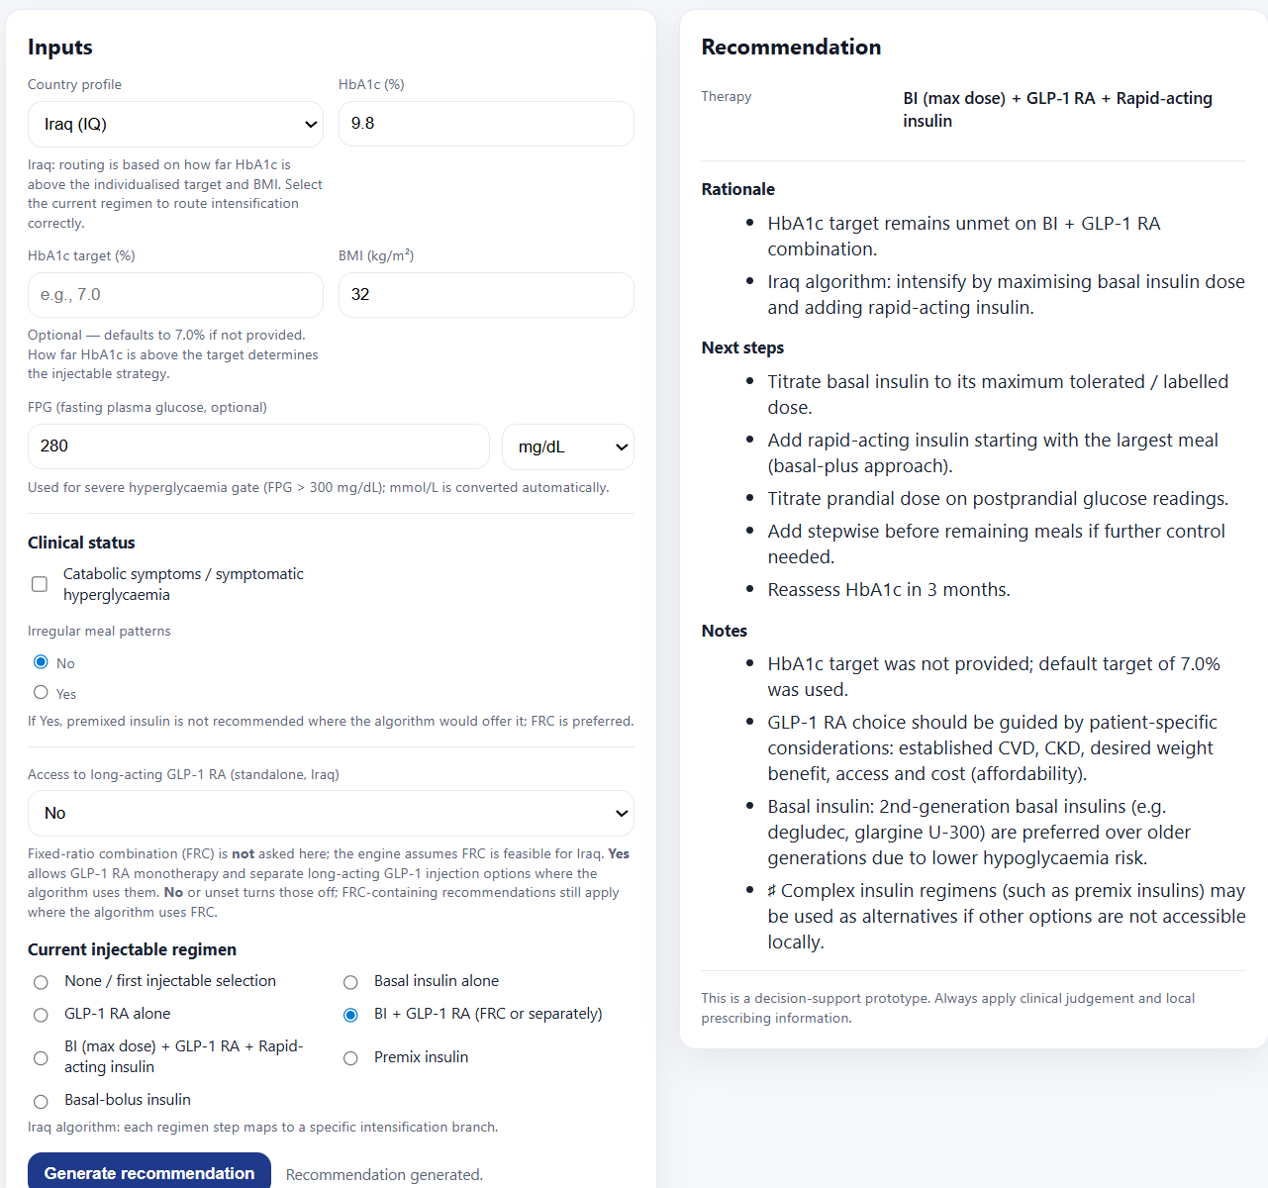

After BI + GLP-1 RA (FRC or separately) Failure Regardless of HbA1c & BMI
Because GLP1 is not accessible, it should remain on FRC
Stepwise addition of rapid…
No access to GLP1-RA

Slide 29
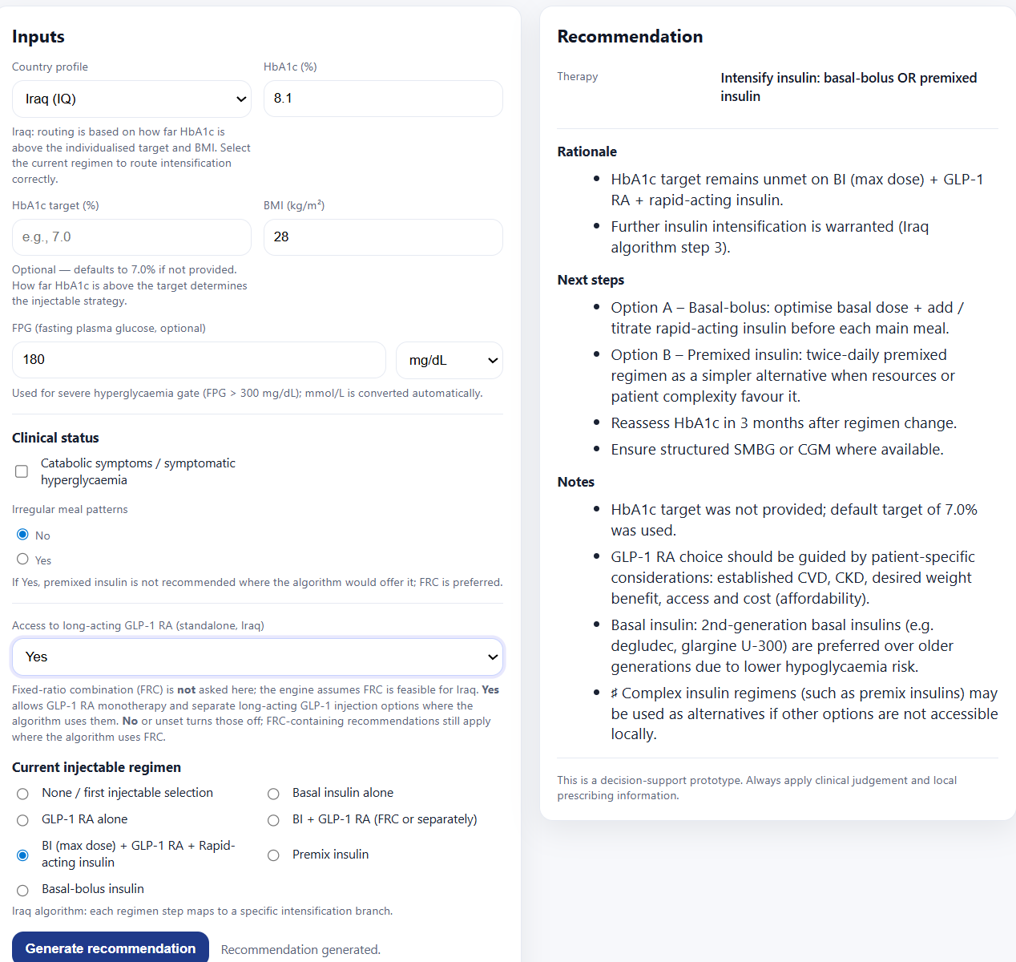

After BI + GLP-1 RA +Rapid Acting Insulin Failure (depends on meal pattern)

Slide 30
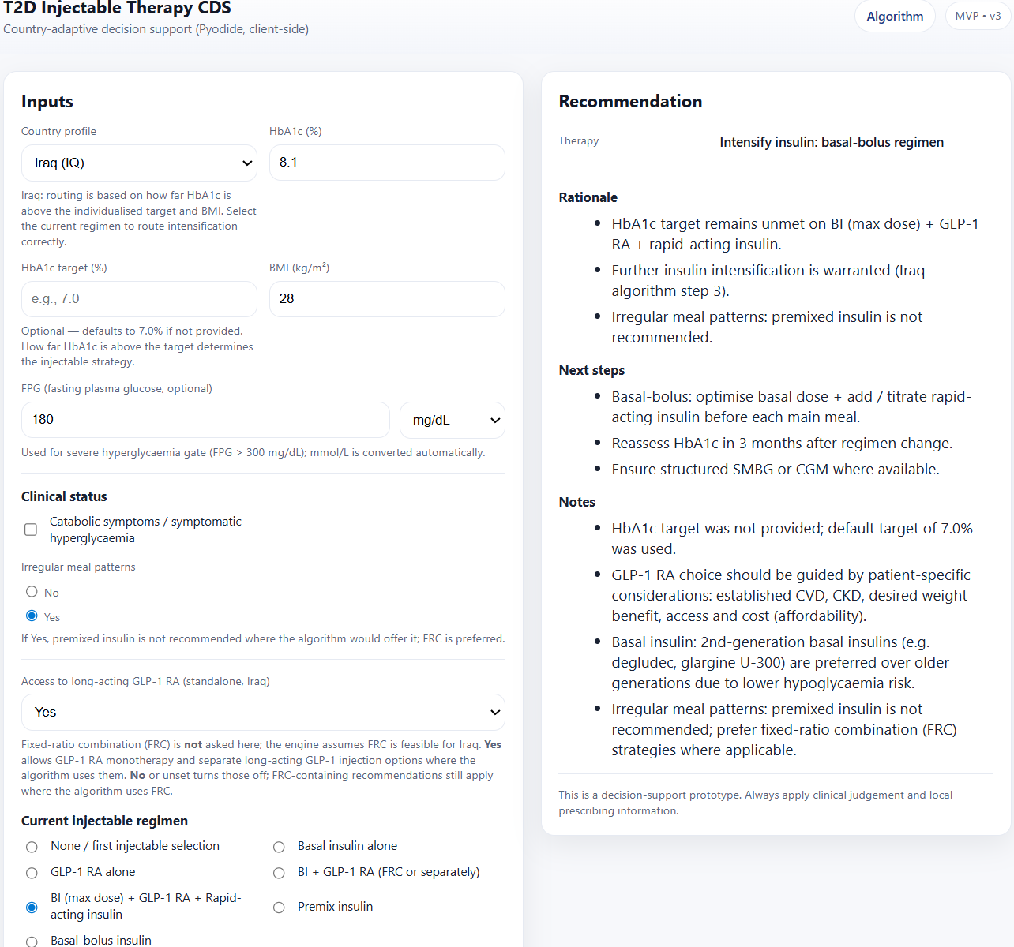
After BI + GLP-1 RA +Rapid Acting Insulin Failure (depends on meal pattern)
Irregular meal pattern
Notes:
BB: increased injection burden / complexity of treatment

Slide 31
After Premix Failure (to elaborate more)
Patient currently on Premix Irregular meals → Switch away from premix BMI >30 + GLP‑1 access → Basal + GLP‑1 Premix insulin sometimes requires twice daily administration, and a switch to a Basal-bolus regimen after six months In settings where simplicity and accessibility are prioritized

Slide 32
(to elaborate more)
Transition considerations after basal bolus :
o Patients failing basal bolus may switch to premix with careful monitoring
o Interest exists in transitioning insulin users to FRCs of BI and GLP-1 RA

